Slide 1

AI-based RTL Code Analysis and Optimization
Yuming Wang
Hochschule HAMM-LIPPSTADT

Slide 2

1. Introduction
Importance of RTL design in modern chip development.
  PPA (Performance, Power, Area) as key optimization targets.
  Growing design complexity increases need for efficient optimization.

Slide 3
IC Design Workflow
Architecture design
RTL design
Combinational Logic;
Clock;
Registers
synthesis
STA
Placement&Routing
FPGA Realization

Slide 4

2. RTL Optimization Targets
Performance: maximizing achievable clock frequency.
  Area: minimizing silicon resource usage.
  Power: improving energy efficiency.
  Early optimization avoids costly design iterations.

Slide 5
3. Traditional Optimization: Hierarchical Flattening
Removes module boundaries to enable global optimization.
  Improves timing, area, and routing efficiency.
  Tradeoff: more difficult debugging and verification.
Better Performance and Area planning
Shorter R2R path,more aggressive logic restructuring
Deletion of redundant gates,rewrite Boolean expression

Slide 6
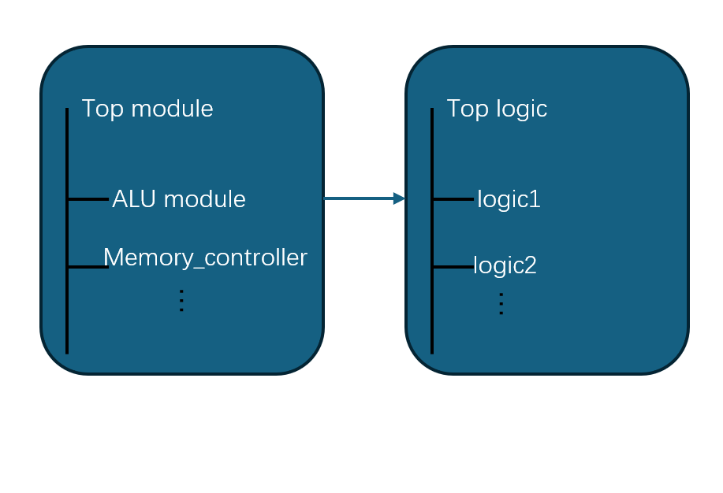
All submodules have their own boundries
Hierarchical design
Flattened design

Slide 7
Automatic transformation
Tools:Vivado ;Synopsys DC
Process is implemented in synthesis step:
Instance Expansion:
Hierarchy Removal:
Logic Merging:
Logic Restructuring:
Flat Netlist
remove boundries
replace submodules by logical parts
remove repeat formulas
rewrite boolean expression

Slide 8
Limitations?
Debugging Difficulty: similar to behavioral design and structural design in VHDL
Reduced reusability: Structures of modules are destroyed!
Increased Complexity: Increased net size after expansion

Slide 9
4. Traditional Optimization: CDC-aware Synthesis
Ensures safe optimization in multi-clock designs.
  Protects synchronization structures.
  Improves timing/area without causing CDC violations.

Slide 10
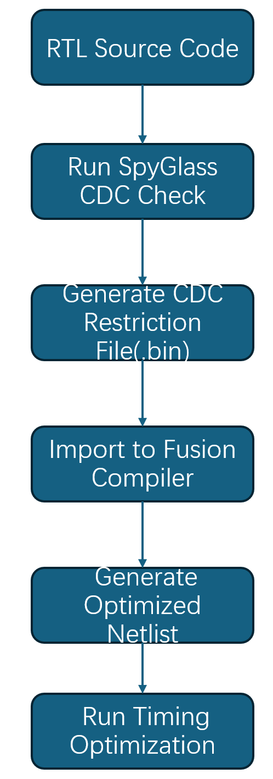
Without this step, synchronized structures will be destroyed

Slide 11
SpyGlass
Use SDC(Synopsys Design Constraints)to detect clock domain
create_clock -name clk -period 10 [get_ports clk]
Check if clock domain crossings correct
Generate CDC restriction file

Slide 12
Flattening optimization + CDC protection

Slide 13
5. AI/ML for RTL Timing Prediction
Machine learning predicts path-level delay from RTL.
  Uses Abstract Syntax Tree (AST) + XGBoost.
  Provides fast identification of timing-critical paths.

Slide 14
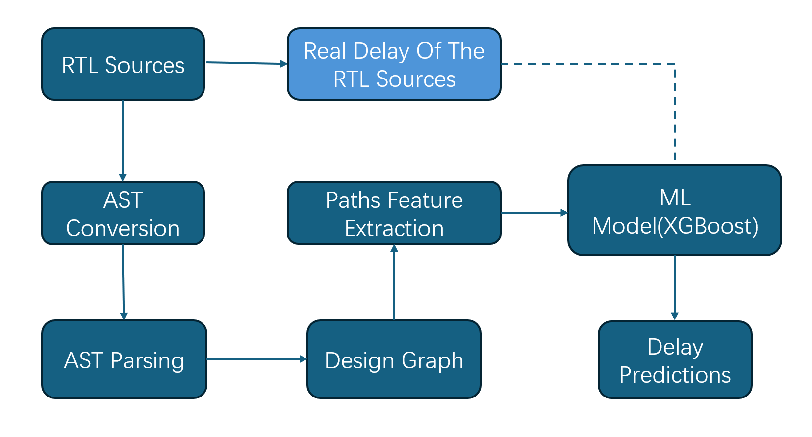

Slide 15

6. ML Timing Prediction Workflow
Parsing RTL into AST using Verilator.
  Extracting graph-based path features.
  Training ML model using post-synthesis delay labels.
  Achieves ~91% accuracy with 40× speedup.
  AST Operation Set:Add / Mul / Compare / If / Case

Slide 16
AST process simple example
process(clk)
begin
if rising_edge(clk) then
if en = '1' then
q <= a + b;
else
q <= a;
end if;
end if;
end process;
Process
└─ If (rising_edge(clk))
└─ If (en = '1')
├Then: Assign(q, Add)
└─ Else: Assign(q, a)
a / b → ADD → q (register)
VHDL
AST
Design Graph
[logic_depth = 1,
arith_ops = 1,
bitwidth = 32,
conditional = 1]
ML Model
Path-level features

Slide 17
7. MasterRTL Framework Overview
Pre-synthesis PPA estimation based on bit-level representation.
  Introduces Simple Operator Graph (SOG).
  Separates models for timing, area, and power prediction.

Slide 18
8. Simple Operator Graph (SOG)
Decomposes RTL operations into single-bit primitives.
  Graph resembles gate-level netlist for ML readiness.
  Improves generalization across different designs.
  SOG only contains simple operation set:
XOR
AND
OR
NOT
MUX
Register

Slide 19
SOG
q[0] = a[0] XOR b[0]
c1 = a[0] AND b[0]
q[1] = a[1] XOR b[1] XOR c1
c2 = (a[1] AND b[1]) OR (c1 AND (a[1] XOR b[1]))
...
q<=a + b;
Parsing into bit-level
a[0] ─┐
XOR ── q[0]
b[0] ─┘
\
AND ── c1
a[1] ─┐
XOR ── t1 ─┐
b[1] ─┘ XOR ── q[1]
c1 ───┘
SOG

Slide 20
How to use SOG for ML/AI models
For Timing/Performance :
1):choose a path between register and register
2):Feature Vector: Extract bit-level depth,numbers of XOR/AND/MUX gates
[depth=14, xor=6, and=5, mux=3, reg_dist=1]

Slide 21
How to use SOG for ML/AI models
For Area Goal: The features we are getting are:
1):Number of AND nodes
2):Number of XOR nodes
3):Number of registers(most crucial one as FF area is much larger than XOR or AND!!)
4):Total numbers of Nodes

Slide 22

How to use SOG for ML/AI models
For Power goal: The power here is dynamic power:
Features we want to get can be divided into 2 aspects:
1):Structure of SOG(AND/XOR/MUX/Register numbers)
2):toggle rate
The AI/Machine Learning model is learning:
RTL circuit in SOG A+Toggle rate B -> Power C

Slide 23
Comparison of AST&SOG
 | AST | SOG
Expression level | Code/grammar | Bit-level
Near to gate-level? | No | Yes
Suitable for ML | Normal | Excellent
Suitable for PPA? | Partly(typically Timing) | Yes
Basic Unit | Expression | Logic gate

Slide 24
9. MasterRTL Performance
Correlation: Timing (0.96), Power (0.89), Area (0.98).
  Requires ~5% of synthesis runtime.
  Outperforms AST-based methods.

Slide 25
10. Commercial EDA Tools
Synopsys Design Compiler: timing-, area-, power-aware synthesis.
  Cadence Genus: parallel architecture, strong physical correlation.
  Used for industry-grade optimization and signoff.

Slide 26
11. Open-Source Tools
Yosys: open-source logic synthesis.
  Verilator: fast simulation + AST extraction for ML.
  OpenROAD: fully automated RTL-to-GDS flow.

Slide 27
12. Conclusion
Traditional and AI-based methods complement each other.
  AI enables faster, earlier PPA prediction.
  Future direction: tighter integration with physical design flows.

